Slide 1
Solar Energy Forecasting Using Weather Data and ML methods Bradley Payne
Motivation
Electricity production contributes roughly 25% of yearly global greenhouse gas emissions. As the world seeks to move to a carbon free future, alternative energy sources must be balanced into the grid.
Solar energy production is weather dependent and fluctuates throughout the day.
Objective Predict the average amount of energy generated by a 100 KW solar panel grid over the next hour

Slide 2
Problem Definition
Inputs
Historical weather data from USU Climate Center that contains 33 feedable input variables including temperature, pressure, precipitation, etc.
Solar coordinates
Month and day encoded as coordinates
Find
Average energy generated (KW) over the next hour, using data from 100 KW grid from Aspire labs for fitting

Slide 3
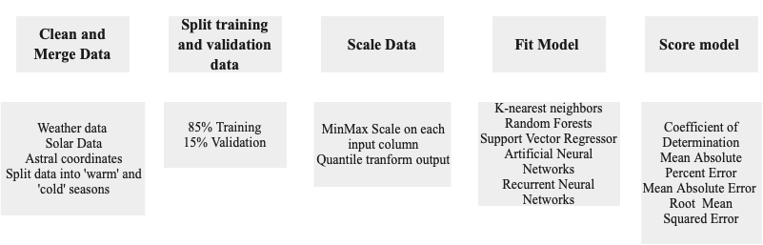
Methods

Slide 4
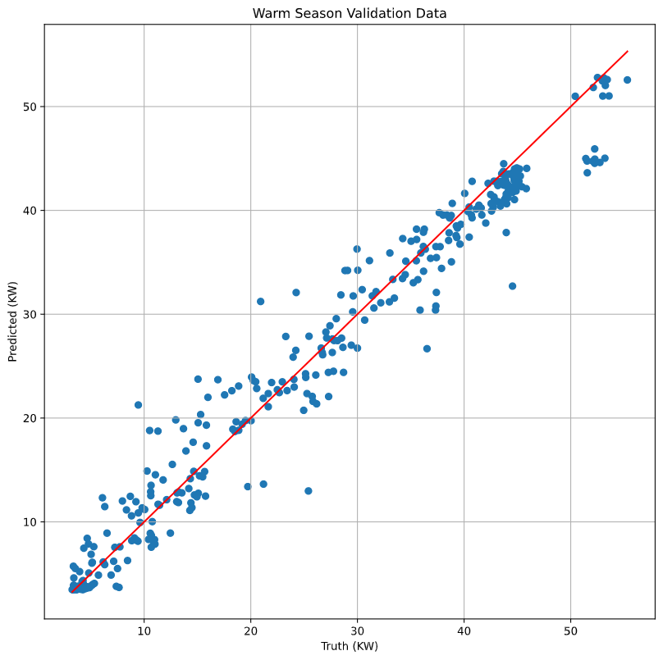
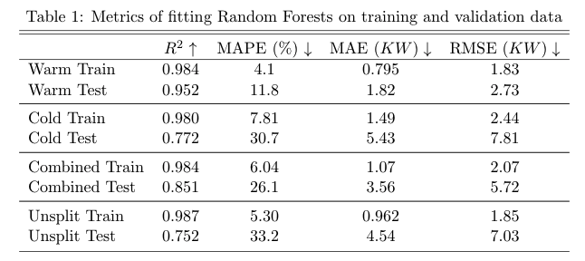
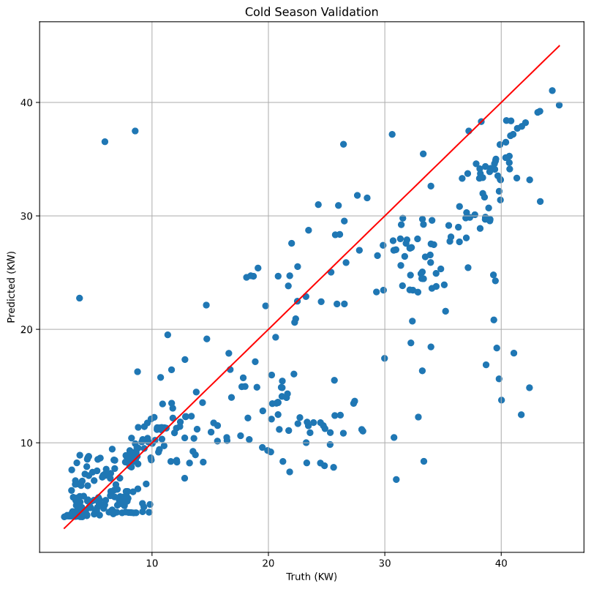
Results
Random forests performed best in every experiment

Slide 5
Wrap-up & Conclusions
Conclusions
This project produced a model that can predict next hour generation with a reasonable amount of error.
Scaling output data to a normal distribution helps the model to not underestimate generation during peak hours.
Fitting models based on seasons produces lower error than using a model fit on several.
Future work can adapt this model and data set to be compatible with weather forecasts.
Additional future work can integrate the generation and demand prediction to make an optimal use/store decision.

Slide 6
References
https://www.epa.gov/ghgemissions/global-greenhouse-gas-emissions-data
https://climate.usu.edu/mchd/dashboard/dashboard.php?network=USUwx&station=1279257&units=E&showgraph=0&

